Slide 1
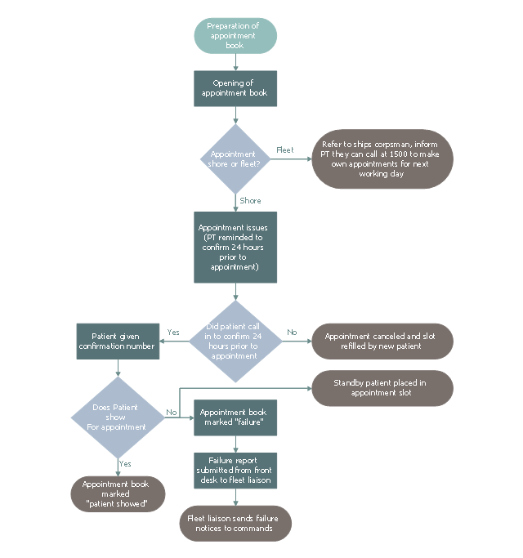
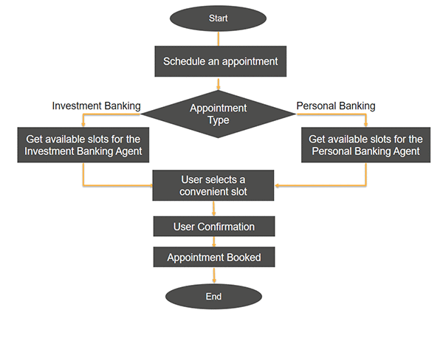
Start
Preparation of appointment bot
Schedule an appointment for?
Hair Salon
Hospital
NGOs
Lawyers
User selects a convenient slot
User confirmation
Appointment booked
Access in Google Calendar API

Slide 2
End

